Slide 1
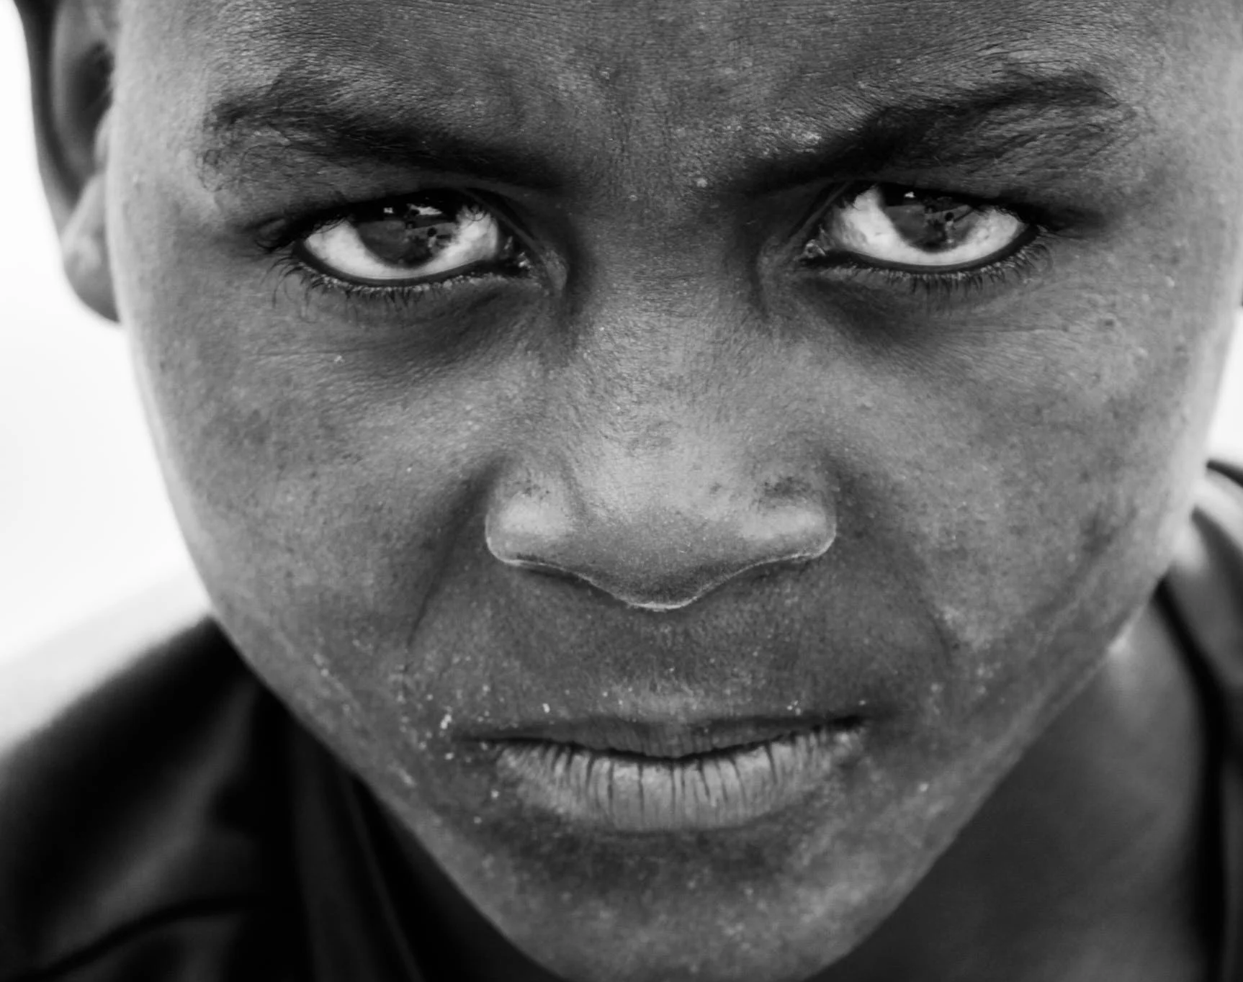
STRONGER TOGETHER IN FAITH
CHILDREN AT RISK
By Linda Ambrose
Children’s Ministries Director NCC
Notes:
This is the topic for this year. World Day of Prayer for Adventists is on May 21, but the VIVA organization have an entire weekend, June 4-5. You can do it when you have a slot available in your church.

Slide 2
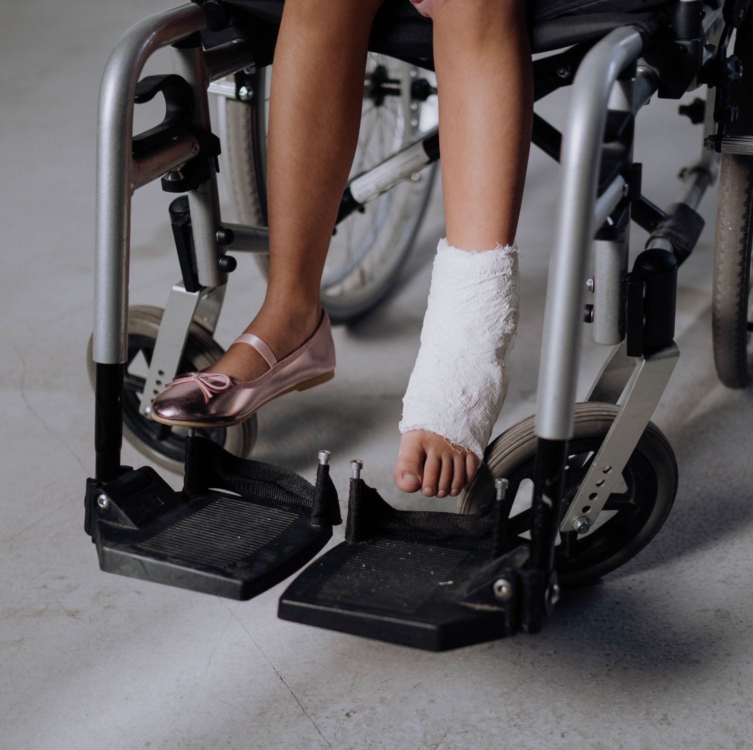
Can you come up with some reasons children may be at risk for abuse or neglect?
1.
2.
3
Notes:
Answers are on the next slide.

Slide 3
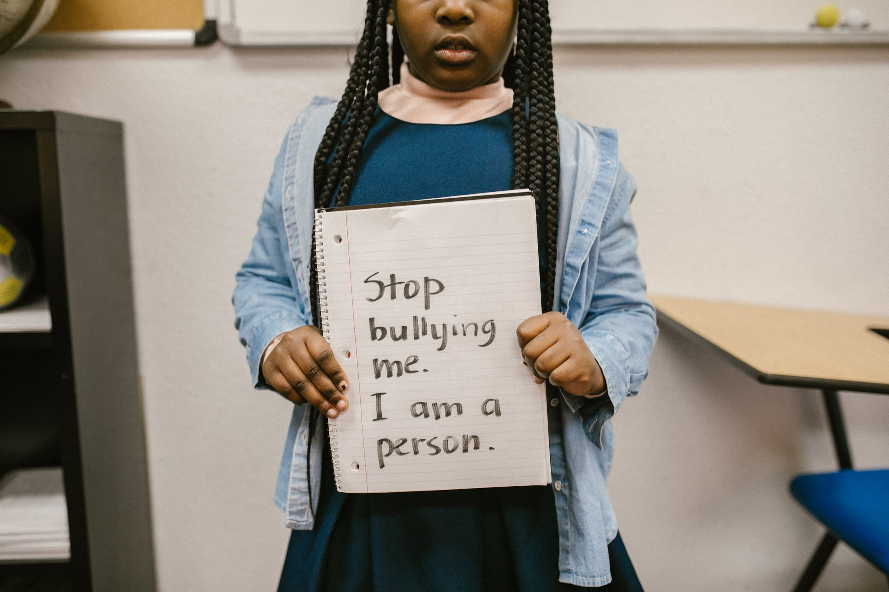
CHILDREN MAY BE AT RISK BECAUSE
A parent/guardian/teacher uses illegal substances.
One or both of their parents/guardians are too busy.
One or both of their parents/guardians are challenged mentally or physically.
One or both of their parents have died.
Their parents are poor.
The child is physically or mentally challenged.
A teacher, parent or guardian just doesn’t care.
Because someone doesn’t like the color of his/her skin.

Slide 4
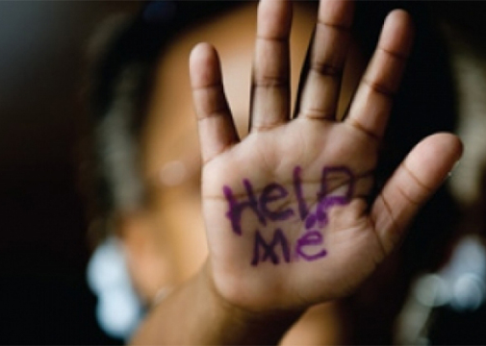
Do you have any ideas how you can help children in your community who are at risk?

Slide 5
At Risk for Bullying
Notes:
Let children answer but share these answers if they don’t mention them. 1. Make sure you’re not bullying anyone. 2. Tell a teacher or parent if you see bullying. 3. Make friends with a child who’s being bullied. 4. Make large signs against bullying. 5. Talk about it on the radio, on social media, etc.

Slide 6
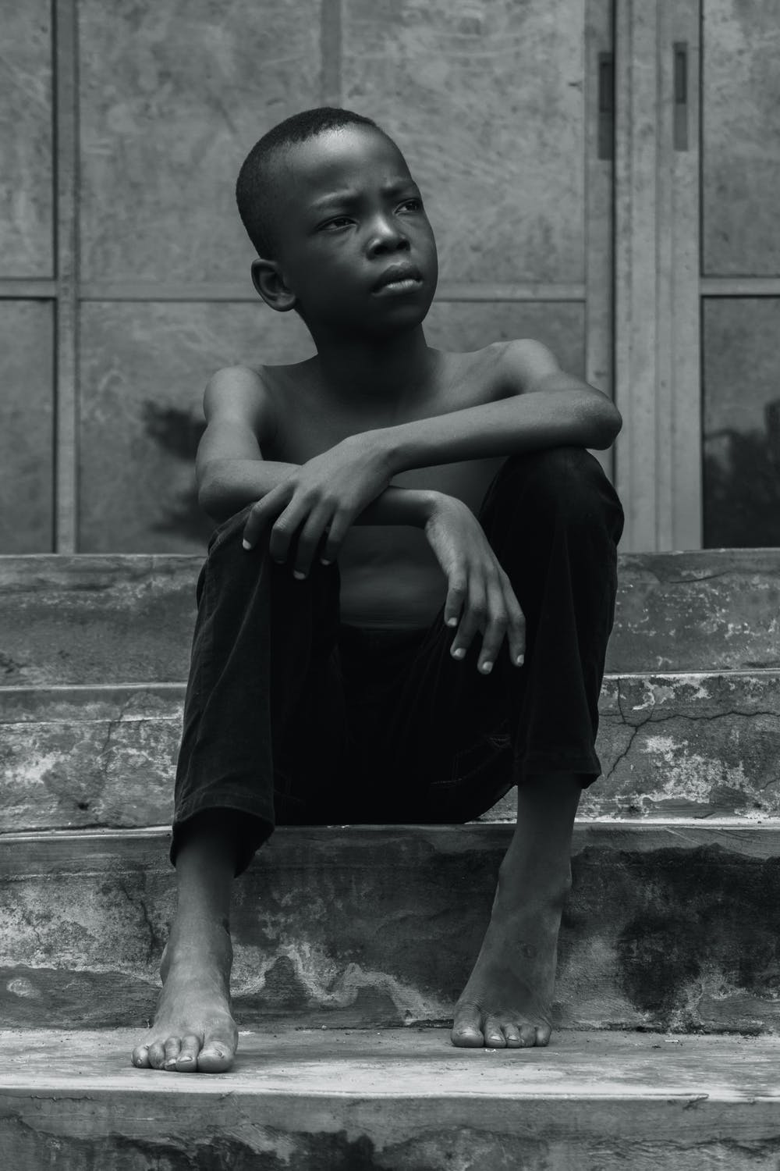
At Risk for Neglect
Little or no food
Not attending school
No warm clothes in cold places
Notes:
1. Ask your parents to help you put aside money every month to help someone who doesn’t have enough food, or clothes, or what is needed to attend school. 2. Ask your teachers to start a ”No Child Left Behind” fund. 3. Pray to God for wisdom and help.

Slide 7
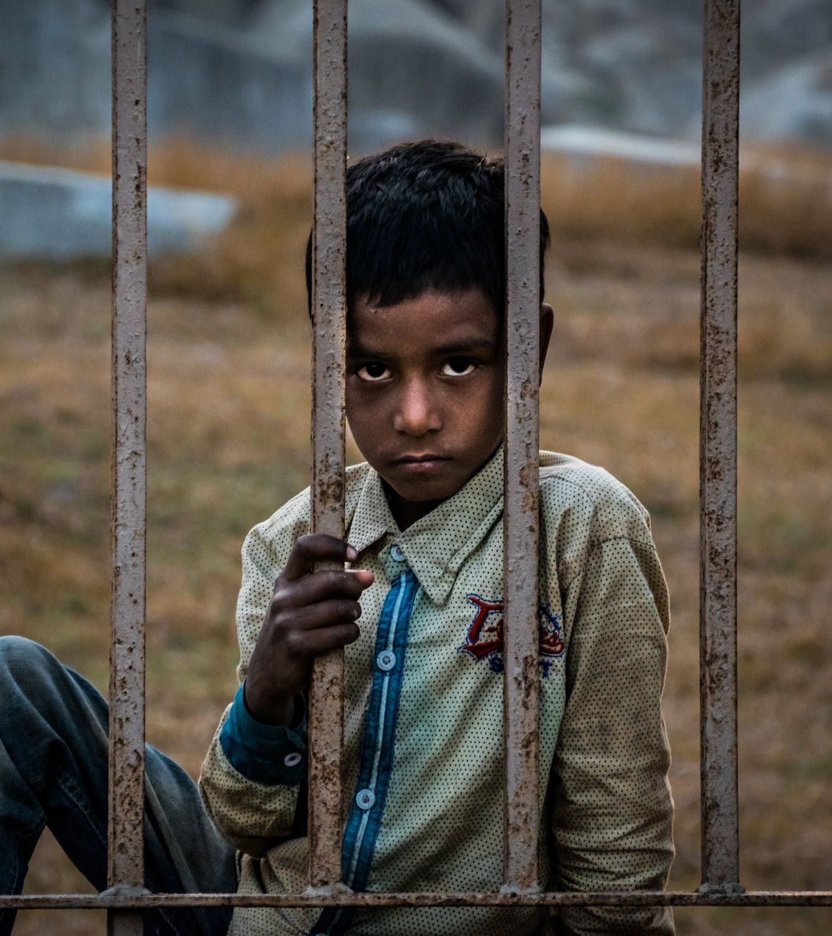
At Risk for Human Trafficking
Notes:
1. Keep your eyes open for children that look scared. Tell your parents what you see. Do not approach an adult you do not know. 2. Make sure you don’t become a target, stay in safe zones. Call the police if you see something suspicious.

Slide 8
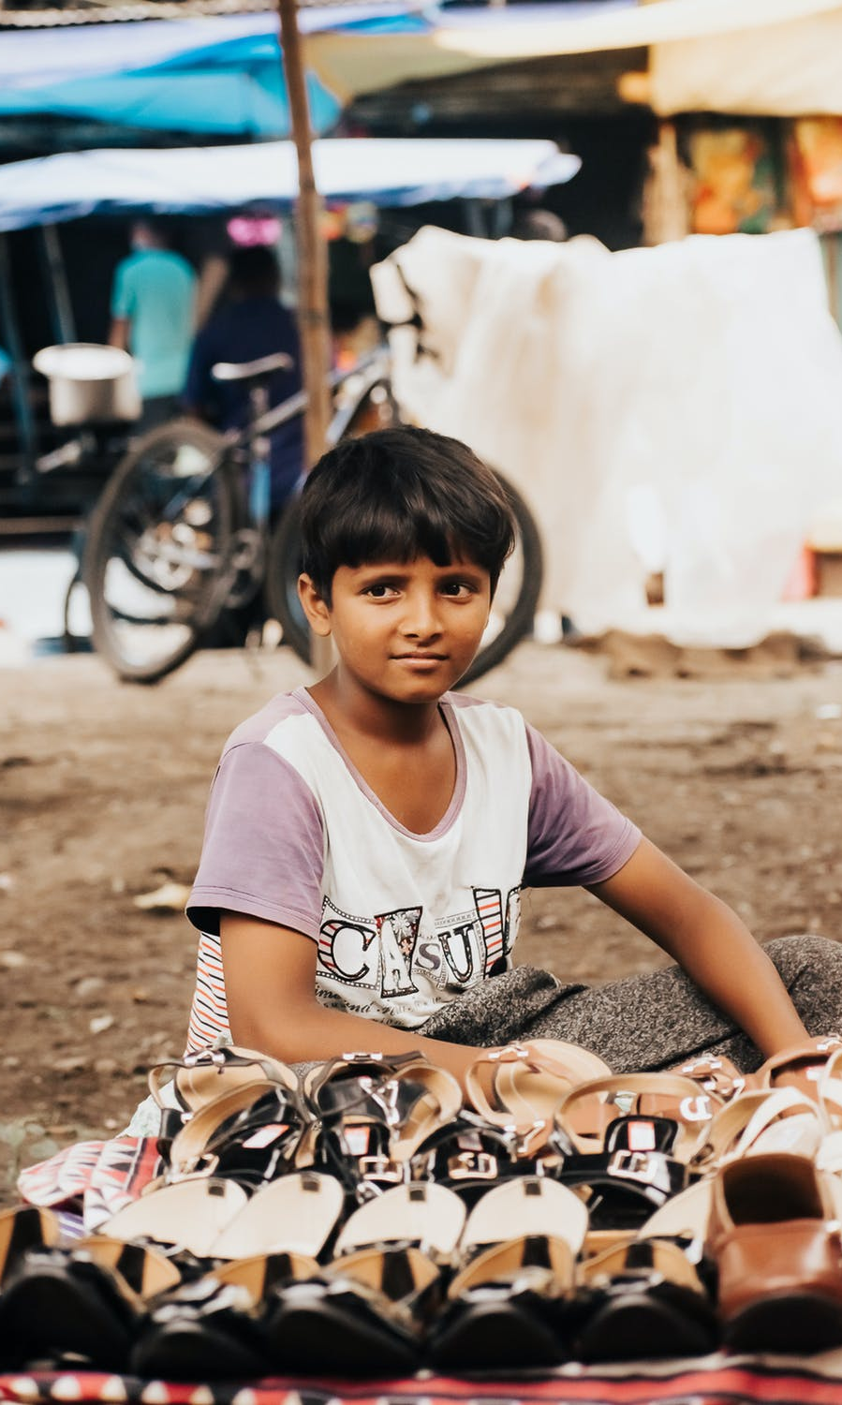
At Risk for Illegal Child Labor/Labour
Notes:
1. Tell your parent/guardian if you see a child going to work most of the time instead of school. 2. Start a fund to help families who are poor so they can let their children go to school instead of sending them to work. 3. Pray to God for wisdom and for him to help children that are at risk.

Slide 9
At Risk for Physical Abuse
Notes:
1. If you see something, say something to a teacher or your parent. 2. If you have an opportunity, speak out against abuse on the radio or social media. 3. Be a part of Women’s Ministries End-it-Now Programs. 4. Pray to God for deliverance for that child.

Slide 10
At Risk for Sexual Abuse
Notes:
1. Tell a teacher or your parent if you see someone touching a child where they shouldn’t touch them. 2. Make sure your friends know NOT to let anyone take pictures of them without clothes. 3. Don’t post any pictures online without your parent/guardian’s consent. 4. Pray to God for guidance and ask him to help any child that is being abused.

