Slide 1
Fostering Kid’s Time Alone with God by Sally Lam Phoon
Presented by Linda Ambrose

Slide 2
What are these parents thinking?

Slide 3
How often did your parents talk to you about God?
43% Never 32% Occasionally 13% Once a week 13% On a daily basis

Slide 4
What Research says…
More than half of our teens leave the church after high school.
Christian young people today don’t know the Bible as they used to.
They are not transferring their Biblical knowledge into a biblical worldview
*Josh McDowell 15% have a biblical worldview *Barna thinks it’s less than 10%. (Larry Fowler, Raising a Modern-Day Joseph, pp. 27, 28)

Slide 5
Biblical Worldview
We all view this world through a certain set of glasses. Unfortunately, Satan would like to give our children a set of glasses that distorts God’s perfect truth. We want our children to see the world through the perfect lens of God’s Word. Giving our children a biblical worldview is simply giving them the right glasses with which to view the world.
Notes:
A biblical worldview sees God as the author and sustainer of all things. Everything exists for him and by him. It also believes that God’s Word is inerrant and is the source of all truth. When we look at the world through the lens of a biblical worldview, we compare everything we learn, hear, read, and watch with God’s word. We make decisions based on God’s wisdom and not the world’s. (Christina Fox, forthefamily.org)

Slide 6
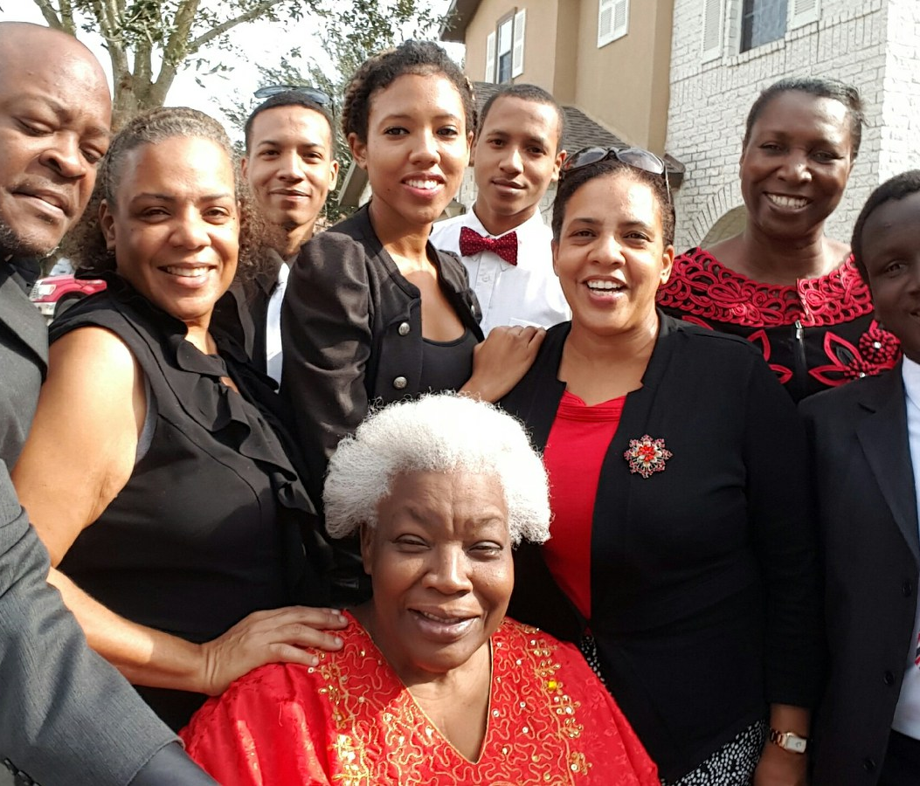
Home, School, Church, and the Community Interaction
Notes:
Home Influences —Mother, Father, Grandparents, Uncles/Aunts and Relatives

Slide 7
Questions Parents/Leaders should Ponder
Am I saved by grace through faith in Jesus Christ?
Do I experience the joy of a new life in Jesus?
Am I am growing every day in my relationship with Jesus?
Do I have time alone with God myself?
Do my children know that I read the Bible and pray daily?
Notes:
Do I believe that God has dreams for my children?
Am I intentional about my children’s spiritual growth and development as much as their physical, academic and social development?
Do I teach my kids to love God’s Word?
Do I lead my kids to worship God?
Do I recognize the importance of helping our children become God’s children, not His grandchildren?

Slide 8
Questions to Ponder
Do I have the skills to be a spiritual mentor for my children?
Is my family comfortable discussing spiritual things?
Is family worship an important part of our family life?
Notes:
Do I walk the talk? *Are you positive in your outlook? *Do you worry and lose your temper when something goes wrong? *Does God’s love shine through your behavior everyday, not only on Sabbath?

Slide 9
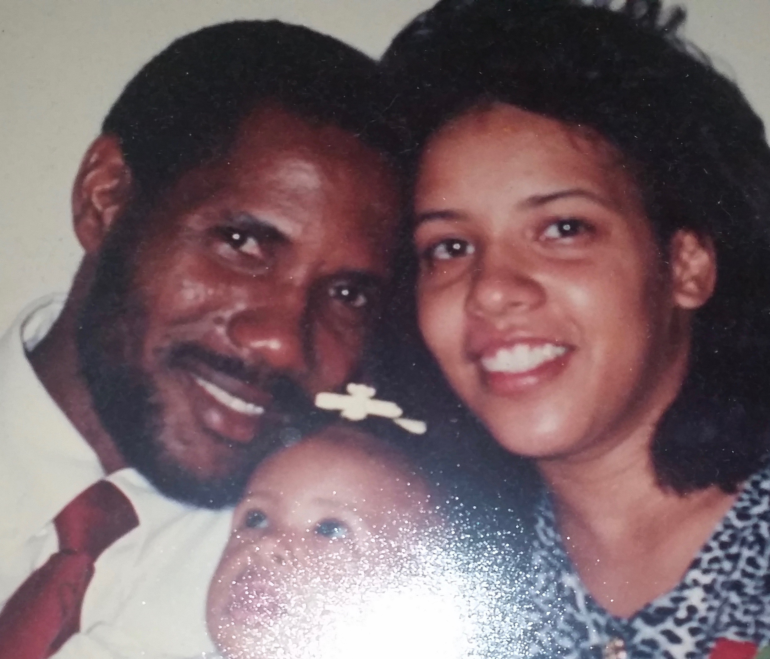
Questions to Ponder
In my relationships *Am I involved with my spouse? *Do the children feel secure with the connection and love between both parents? *Are you involved intimately with your children (fathers especially)? *Are you involved with your close relatives & church family?
Am I active in leading my children in serving others?
Notes:
Am I active in sharing my faith in God with others?
Am I active in leading my children in serving others?

Slide 10
Counsels on Sabbath School Work, p. 20
“Fathers and mothers, we entreat you to take up your long-neglected duties. Search the Scriptures yourselves; assist your children in the study of the Sacred Word. Make diligent work because of past neglect. Do not send the children away by themselves to study the Bible, but read it with them, teach them in a simple manner what you know, and keep in the school of Christ as diligent students yourselves.”

Slide 11
TAG—Time Alone with God
Preparing the heart with prayer
ACTS
*Adoration *Confession *Thanksgiving *Supplication
Notes:
Connecting with the Word
What does this mean to me today?
Praying the Word
Application in real life

Slide 12
Drawing Deep from the Word of God & Prayer
“The lily on the lake strikes its roots down deep beneath the surface of rubbish and slime, and through its porous stem draws those properties that will aid its development and bring to light its spotless blossom to repose in purity on the bosom of the lake.” Ellen White, My Life Today, 263)

Slide 13
Prayer
“Christian parents, morning and evening, by earnest prayer and persevering faith, are to make a hedge about their children. They should patiently instruct them, kindly and untiringly teach them how to live in order to please God.” {1T 397}
Notes:
“Could our children learn these lessons of finding at dawn and twilight a quiet season for communion with their Father in heaven, in the morning of their years, what freshness and power, what joy and sweetness, would be brought into their lives!” – CG 525

Slide 14
How do we foster TAG at the different ages?
0 – 5 years
6-10 years
11-15 years
Notes:
“Give Study to the Early Training—The early training of children is a subject that all should carefully study. We need to make the education of our children a business, for their salvation depends largely upon the education given them in childhood. Parents and guardians must themselves maintain purity of heart and life, if they desire their children to be pure. As fathers and mothers, we should train and discipline ourselves. Then as teachers in the home, we can train our children, preparing them for the immortal inheritance.6The Review and Herald, September 8, 1904.”

Slide 15
“The youth should be carefully and judiciously trained, for the wrong habits formed in childhood and youth often cling to the entire life-experience. May God help us to see the necessity of beginning right.8The Gospel Herald, December 24, 1902.”

Slide 16
“The Plant—An Object Lesson in Child Training—The gradual development of the plant from the seed is an object lesson in child training. There is “first the blade, then the ear, after that the full corn in the ear.” Mark 4:28.” (CG 27)
Notes:
“Children should not be forced into a precocious maturity, but as long as possible should retain the freshness and grace of their early years.” (Ed 107)

