Slide 1
Ministering to Children with Special Needs Linda Mei Lin Koh GC Children’s Ministries Director
Presented by:

Slide 2
What is a special need?
Special = peculiar to a specific person
Need = Lack of something required
REMEMBER: A child with special needs requires individualized attention.

Slide 3
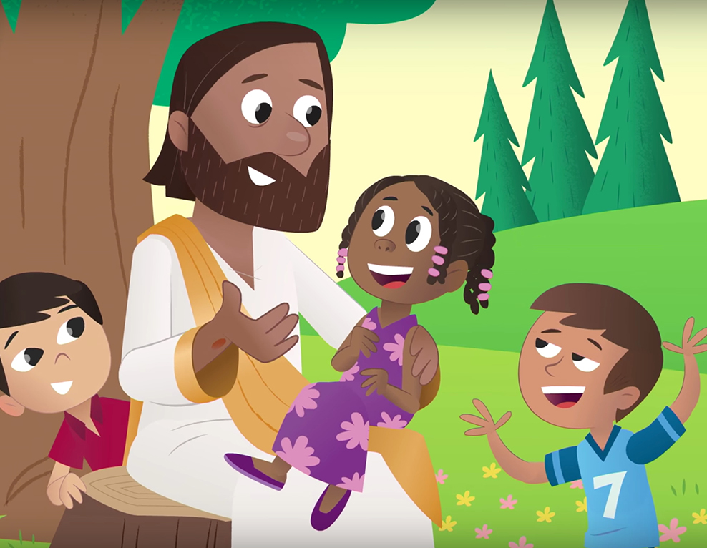
Children with Special Needs are Valuable to God
They remind us that God is good.
They remind us that God is faithful.
They show us that the image of God is within us—not outside us.

Slide 4
The Problem with Labels
Man-made labels create negative effects on the child.
Derogative labels can obscure the vision of God’s words for the child.
Labels limit, degrade, and hurt, and is offensive to God.
Every child, whether differently able or not, is God’s workmanship,
Created in His image (Ephesians 2:10)

Slide 5
People may see | God sees
Cerebral Palsy Cindy | Cindy, handcrafted by Himself before she was even born. Part of her unique knitting pattern is her love for animals and gifted singing voice. She also happens to have cerebral palsy.
Down Syndrome Adam | Adam, image-bearer of Himself, who displays passion for prayer and care for the people in his life. He also happens to have Down syndrome.
Autistic Sam | Sam, honored and significant member of the Body of Christ, who is a gifted servant as he joyfully organizes the toy shelves at church. He also happens to have autism.

Slide 6
Myths About Special Needs Ministry
I can’t serve children with disabilities—I’ve no training
We don’t need a special ministry, there’s one in the church downtown
The children would not understand what is being done
The children would not participate in the activities

Slide 7
Unique Family Challenges of Disabilities
Impact on Siblings
*some accept
*some are frustrated and embarrassed

Slide 8
Unique Family Challenges of Disabilities
Impact on Parents
*need to feel welcome
*parents look for/ and need self-care breaks
*seek religious education for disabled child
*need of friendship (both parent & child)

Slide 9
Unique Family Challenges of Disabilities
Impact on Impact on Grandparents
*most do not have training & strength to care for child)

Slide 10
Church-Family Supports
Provide Financial Aid
Show Unconditional Love
Share Grief
Promise Hope
Supplement Needed Care

Slide 11
Some Special Needs
Visually Impaired Children
Deaf Children
A child who uses a Wheelchair
A child with Chronic Illnesses
Bright Children
Gifted Children
High Energy Level Children

Slide 12
Types of Disabilities
Autism
Learning Disabilities
Developmental Disabilities
Visual and Hearing Impairments
Speech and Language Impairments
Emotional and Behavioral Disorders

Slide 13
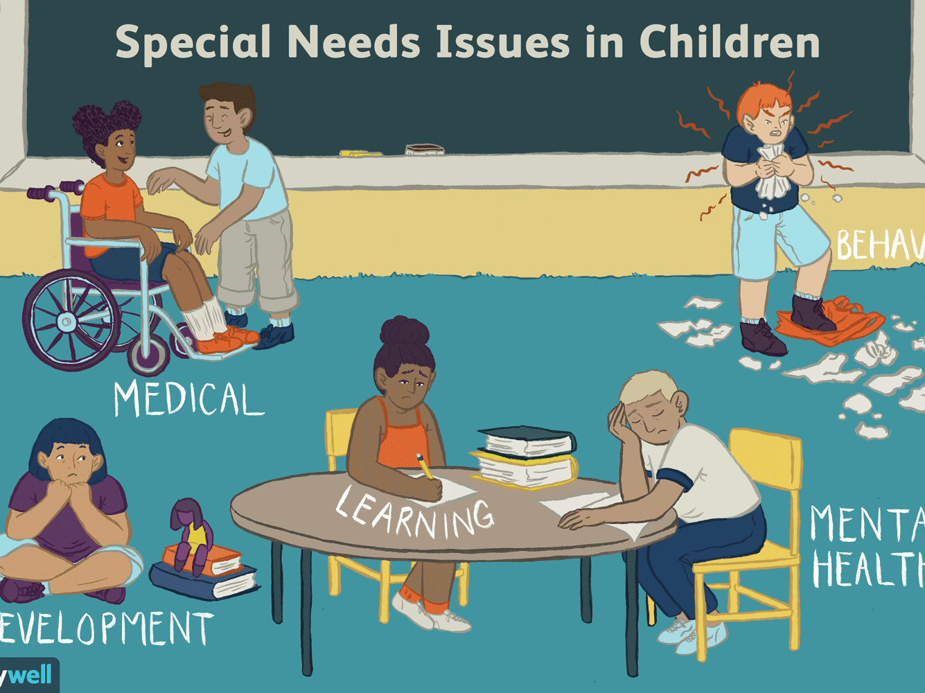

Slide 14
U. S. Children (Ages 3-17) Need a Hand Because . . .
1 in 800 born with Down Syndrome
4. 7 million children have learning disabilities.
3.4 children out of 1,000 have autism.
2 or 3 children per 1,000 have cerebral palsy.
21% of children have behavioral & emotional difficulties.

Slide 15
What Are Our Responsibilities?
To Remember Each Person is Special
To Share God’s Love
To Be Prepared
To Create A Nurturing Environment

Slide 16
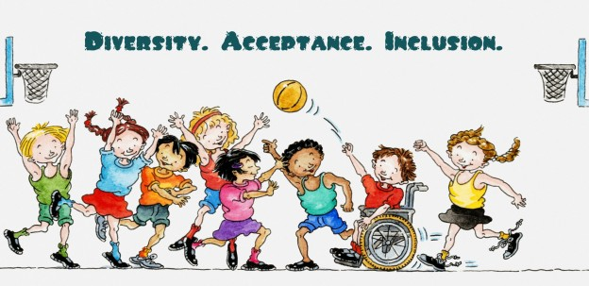
Many have learned that…
A Person who hears less may see more.
One who sees less may perceive more.
One who speaks slowly may have more to say.
A Person who moves with difficulty may have a clearer sense of direction.

Slide 17
A Prepared Teacher will …
Know all of his/her students.
Plan with each student in mind.
Ask for assistance.
Pray for the out-pouring of the Holy Spirit.
Know his/her own weaknesses.

Slide 18
It’s You I Like
It’s You I Like,
It’s not the things you wear,
It’s not the way you do your hair –
But it’s you I like.
The way you are right now,
The way down deep inside of you –
Not the things that hide you,
Not your toys –
They’re just beside you

Slide 19
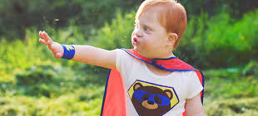
It’s You I Like
But it’s You I like,
Every part of you,
Your skin, your eyes,
Your feelings
Whether old or new
I hope that you remember
Even when you’re feeling blue
That it’s you I like,
It’s You yourself
It’s You, it’s You I like.

Slide 20
QUESTIONS ?

