Slide 1
Children's Ministries Leadership Certification
Level III, Course 3
Partnering With Parents
Prepared by Julie Weslake,
Children’s Ministries Director, SPD
Illustrated by Debra Henry
Children’s Ministries Director, CARU

Slide 2
Parents are primary spiritual mentors of children and it is essential to extend ministry into the home and partner with them.

Slide 3
No one has more potential to influence a child’s relationship with God than parents.

Slide 4
Parents know your children
Spend quality time with them
Build relationships
Develop trust
Teens usually choose mom first then dad

Slide 5
Parents Need To:
Incite Wonder
So children grow up continually amazed at how great God is and how much he loves them.
Provoke Discovery
So children can pursue a lifestyle of building a relationship with Jesus and be guided by His word and spirit.

Slide 6
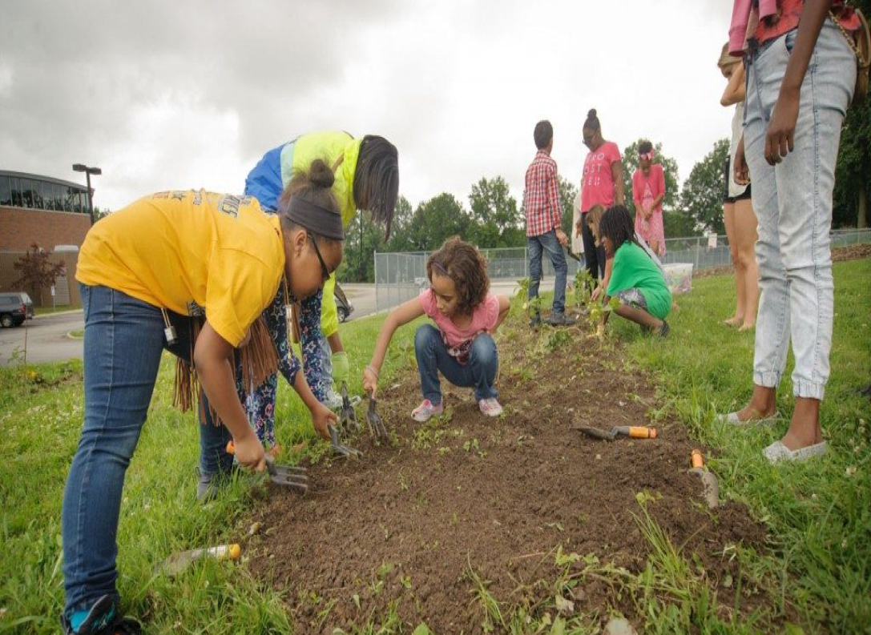
Fuel Passion
So children can have a sense of passion that will drive them to be like Jesus and do as He did.

Slide 7
Impress Your Children
“Impress them on your children. Talk about them when you sit at home and when you walk along the road, when you lie down and when you get up.”
Deut. 6: 7

Slide 8
Meals Time
When you sit at home, focus discussion as a teacher to establish core values
Driving
When you walk along the road
Informal talking as a friend to help your child interpret life

Slide 9
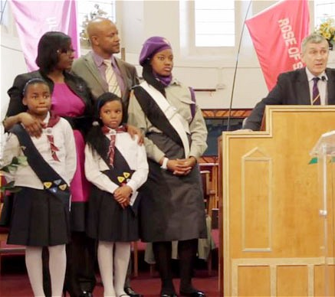
UNITY BETWEEN CHURCH AND HOME IS ESSENTIAL

Slide 10
Parents are Valuable
Believe in your parents
Spiritually nurture them
Give them the vision of spiritual mentoring
Equip them

Slide 11
Parental Advice
1.Read Bible stories to children at bedtime throughout childhood.
2. Make character building story books available for them to read.
3.Share thoughts from your devotions and encourage children to share theirs.

Slide 12
Family Rituals are valuable
Provide meaning to our lives
Gives stability
Predictability
Sense of belonging

Slide 13
What did you see today that reminds you that all people are sinners and need Jesus?
What did you hear or see today that did not agree with the truths of the Bible?
What part of God’s creation did you enjoy most?
What happened to you today that reminded you of God?
Faith Talk

Slide 14
Faith Talk
5. What is one thing that you would like to do before you die?
6. What is something that happened to you recently that made you pause and thank God?
What did you learn at church today?
How is this going to change your life?

Slide 15
Family Times Should Be:
Enjoyable
Relaxed
Routine
Regular
Intentional

Slide 16
Church’s Responsibility
Provide home resources
01
Conduct classes: How to lead your child to Christ.
02
How to read the Bible.
Encourage parents to be involved in Children’s Ministries activities.
03

Slide 17
Church’s Responsibility
Encourage and support
Help them connect with other parents
Celebrate families and events
Communicate regularly
Be positive

Slide 18
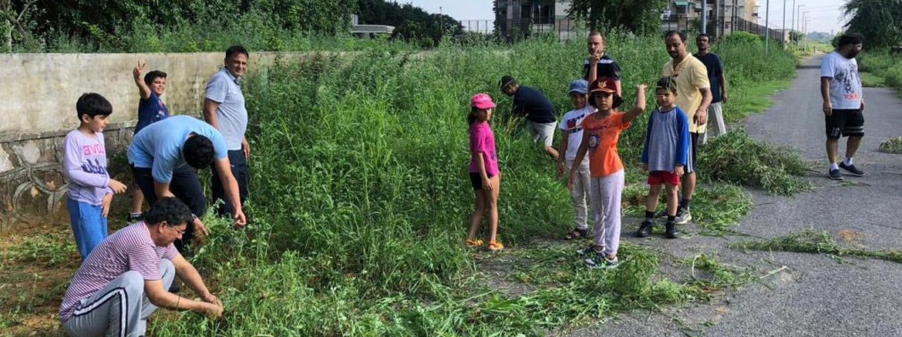
Family Service Projects
What could you do to help a neighbour?
What could you do to help preserve the environment?
What could do to help at church?
What could you give to the needy?

Slide 19
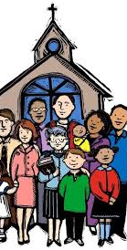
The church can give the family hope and direction!

