Slide 1

TEENS & RELIGION
Notes:
Teens and Religion

Slide 2
Why Do We Need to Understand Teens?
Teens largely define the values and leisure endeavors of the nation.
The economy is substantially shaped by their choices as consumers and their work habits in the work force.
The nature of the family depends on how teens prioritize family and approach parenting.
The future of the Church will be determined by their faith commitments.
Notes:
Why Do We Need to Understand Teens? (Barna)
According to George Barna, studying teens is a task undertaken by few individuals. For the most part, parents hope to survive the teenaged years of their kids so they will feel they have earned retirement; teachers expect icon status for managing young adults; and church youth workers see such a ministry as a means of retaining a “in touch” image among their peers and elders.
But teenagers do matter to us. There are at least 4 significant reasons whey every adult should take the time and make the effort to understand the teenaged bastion that populates our country.
Teens largely define the values and leisure endeavors of the nation.
The economy is substantially shaped by their choices as consumers and their work habits in the work force.
The nature of the family depends on how teens prioritize family and approach parenting
The future of the Church will be determined by their faith commitments.

Slide 3
“Adolescence is an age where the individual is concerned with what is spiritual and sacred.”
Samuel Pfromm Netto, Psychology of Adolescence, 307
Notes:
“Adolescence is an age where the individual is concerned with what is spiritual and sacred.”
Samuel Pfromm Netto, Psychology of Adolescence, 307.

Slide 4
Religious Needs of Teens
They need to have a good relationship with religious authorities, such as parents and teachers so that they can see in them coherence between what they live and what they preach.
They need to have correct concepts regarding religion at this time on their own so that they opt for the faith in Jesus.
Notes:
Religious Needs of Teens
They need to have a good relationship with religious authorities, such as parents and teachers so that they can see in them coherence between what they live and what they preach.
They need to have correct concepts regarding religion at this time on their own so that they opt for the faith in Jesus.

Slide 5
■Many think teenagers do not like/are not interested in religion.
■ Studies have shown that “adolescence is an age where the individual is concerned with what is spiritual and sacred.”
■ It’s true that this phase of teenage life produces radical transformations not only in confronting their relationship with God, but with all aspects of their life.
■ The individual is no longer a child, so that by himself, he may discover manner and forms of living and religion that was taught to him.
Some Facts about Teens & Religion
Notes:
Some Facts About Teens and Religion
■ Many think teenager do not like/are not even interested in religion.
■ Studies have shown that “adolescence is an age where the individual is concerned with what is spiritual and sacred.”
■ It’s true that this phase of teenage life produces radical transformations not only in the form of confronting the relationship with God, but with all aspects of their life.
■ The individual is no longer a child, so that by himself, he may discover manner and forms of living and religion that was taught to him

Slide 6
Teenage is the Best Phase of Life for Religion
Religious concepts gain more precision and depth in the final years of childhood and during puberty.
It is the best phase of life to strengthen religious values and a relationship with God.
Notes:
Teenage is the Best Phase of Life for Religion
Religious concepts gain more precision and depth in the final years of childhood and during puberty.
It is the best phase of life to strengthen the values of religion and a relationship with God.

Slide 7
Teenage is the Best Phase of Life for Religion
It is in the teenage years that conversion take place; it is the period in which the majority of religious leaders decided to be ministers and missionaries (McDowell, 317)
Notes:
Teenage is the Best Phase of Life for Religion
It is in the adolescence age that conversion take place; it is the period in which the majority of religious leaders decided to be ministers and missionaries. (317)
Then, what happens in the teen years? If there is a concern and an interest for spiritual matters, why at times is there such indifference?

Slide 8
What Are Teens Seeking?
They seek in religion its rationality and its logic.
They question religion for its values and its practical utility.
They want to know if religion is useful for something that is meaningful in life.
Notes:
What Are Teens Seeking?
They seek in religion its rationality and its logic -- It is because that through their nature the adolescent is a reformer of the world and religion does not escape their criticism.
They question religion for its values and its practical utility -- The problems that they have with religion are not because of religion itself, but because of poor models of parents and religious leaders.
They want to know if religion is useful for something that is meaningful in life. -- They want a more authentic religion of reflection, with less routine, and more awareness. What good does this do me? What has the church’s teachings produced in the life of the believers? Is this worthwhile to get into this?
What commonly happens at this age “is the loss of enjoyment for religion and for everything that has to do with religion, because of the practices learned during childhood.” (317)
The child accepts everything that is told to them without questioning. There are many “whys” but few “becauses”. In the teen age years, the “whys” RECEIVE the connotation of “because”.
What is the moral, family, professional conduct of the father and mother? Are they true Christians, or just in appearance? How do the Christians that they know live? Are they one thing in the church and another outside the church?

Slide 9
Key Factors in Teens’ Response
Positive response to religion depends on the role models exhibited by parents and the individuals who affect the religious life of the child and the adolescent.
The rebelliousness of the teen toward religion is a form of rebelling against the people who desire to impose upon them religion which they themselves many times do not practice.
Notes:
Key Factors in Teens’ Response
Positive response to religion depends on the role models exhibited by parents and the individuals who affect the religious life of the child and the adolescent.
The rebelliousness of the teen toward religion is a form of rebelling against the people who desire to impose upon them religion which they themselves many times do not practice.

Slide 10
He wants religion. He is concerned with spiritual matters. He desires the security that religion gives to the human being
Paradox
He rejects it, distances himself from
it, becomes critical, hard and
inflexible because of what he sees
and lives within it
Notes:
Religious Paradox for the Teen
He wants religion. He is concerned with spiritual matters. He desires the security that religion gives to the human being, but
He rejects it, distances himself from it, becomes critical, hard and inflexible because of what he sees and lives within it.

Slide 11
What Separates Teens from Religion?
The quality of the interpersonal relationships between teens and those who exercise religious authority.
Inconsistency between what is professed as belief and what is lived.
Concepts that teens have regarding religion.
Notes:
What separates the teen from religion?
Roger Dudley, a North American educator, states that there are three things that lead the teen to abandon the church.
1. The quality of the interpersonal relationships between teens and those who exercise religious authority over them (parents and teachers).
2. Inconsistency between what is professed as belief and what is lived.
3. Concepts that teens have regarding religion.
What type of religion is needed?
Religion is questioned, its values, its practical utility, become the target of “rebellious” fire from that child who during his entire life was docile and submissive.
However for the teenager, religion is dogma, philosophy, ideology, abstract concepts for which they are not very interested. What the teen truly wants is to know if this IS USEFUL for something. And the only manner of knowing this is analyzing the religious life of the individuals who he knows.

Slide 12
Religion, Identify and Independence
When the young teen establishes differences between himself and his parents, he can reach the point of not accepting some values and customs adopted by them, as a means of seeing himself as a person with his own identity.
Notes:
Religion, Identify and Independence
One of the most important tasks of adolescence is obtaining independence, emotional as well as economic. This implies reaching a sense of identity. One key question for the teen is: “Who am I?...”
When the young teen establishes differences between himself and his parents, he can reach the point of not accepting some values and customs adopted by them, as a means of seeing himself as a person with his own identity.

Slide 13
The rebellion or challenge of the
teen is related to his uneasiness
regarding his identity. In his
declaration of independence, he
rejects the concepts and teaching
of his initial phase.
Notes:
“The rebellion or challenge of the teen is related to his uneasiness regarding his identity. In his declaration of independence, he rejects the concepts and teaching of his initial phase”.

Slide 14

If parents or other authority figures understand the necessity and the nature of the process of emancipation, they can really help with intelligent and understanding guidance. If we impose value system on teen, not allowing him to obtain a separate identity
Rejection of
religion
Notes:
If parents or other authority figures understand the necessity and the nature o f the process of emancipation, they can really help with intelligent and understanding guidance. But if they fight against the process, trying to impose their value system on the teen, not allowing him to obtain a separate identity, the result can be: Rejection of religion.

Slide 15

Are Teens Really Rejecting Religion?
Teens are not directly against religion, but against the authority which sustains religion.
Such rebellion is the personal method of the young person to free himself from the restrictions that hinder him from obtaining a separate personality.
The more rigid and authoritarian the religious authority is, especially when it is combined with severity and impatience, the more the teen will reject religion.
Notes:
Are Teens Really Rejecting Religion?
Teens are not directly against religion, but against the authority which sustains religion.
Such rebellion is the personal method of the young person to free himself from the restrictions that hinder him from obtaining a separate personality.
Therefore, the more rigid and authoritarian that the form of applying religious authority be, especially when it is combined with severity and impatience, the more the teen will reject religion.
Then the distancing of the adolescent youth from religion can be attributed in a large part to the quality of the interpersonal relationships between adolescents and their parents and teachers, especially in the dimension that these relationships have to do with religious values.
“… ‘Not by might nor by power, but by my Spirit,” says the LORD Almighty.” (Zechariah 4:6, NIV)

Slide 16
The National Study of Youth and Religion
1. Religious Participation
Teens are relatively actively in religious organizations and activities.
Teens attend Sunday school, church, or youth groups, pray and study the Bible.
Notes:
The National Study of Youth and Religion
Religious Participation
Teens are relatively actively in religious organizations and activities.
Teens attend Sunday school, church, or youth groups, pray and study the Bible.
Teenagers are relatively active in religious organizations and activities, both within and beyond their churches. About one-half of all teens surveyed attend church weekly, with their parents and peers, participate in Sunday school or in a religious youth group, pray and attend a religious summer camp or retreat, though less than one-third read the Bible each week. This also means, however, that substantial numbers of teens are not actively participating in their religious traditions.

Slide 17
The National Study of Youth and Religion
2. Theological Beliefs
Teens are likely to hold many traditional Christian religious beliefs.
Majority of teens believe in God, afterlife, angels, miracles, demons, judgment.
Notes:
The National Study of Youth and Religion
2. Theological Beliefs
Teens are likely to hold many traditional Christian religious beliefs.
Majority of teens believe in God, afterlife, angels, miracles, demons, judgment.
Teens also view God as a personal being involved in the lives of people today. Sizable numbers of Protestant teens, on the other hand, do not hold these traditional values sacred.

Slide 18

The National Study of Youth and Religion
3. Christian Religions Beliefs
Teens from conservative denominations more likely than mainline teens to hold these religious beliefs.
Notes:
The National Study of Youth and Religion
3. Christian Religions Beliefs
Teens from conservative denominations more likely than mainline teens to hold these religious beliefs.

Slide 19

The National Study of Youth and Religion
4. Importance of Faith
Majority of teens report that their religious faith is very important in their lives.
Most of them have shared their faith with someone not of their faith & have had a powerful worship experience.
Notes:
The National Study of Youth and Religion
4. Importance of Faith
Majority of teens report that their religious faith is very important in their lives.
Most of them have shared their faith with someone not of their faith & have had great worship experience.
Most of them also say that their families talk about religion together and the importance of sharing their faith. A large minority of all teenagers, and in the case of some denominations a majority of teenagers, do not report that religious faith is very important in their lives.

Slide 20

The National Study of Youth and Religion
5. Evaluation of Churches
Majority of teens express relatively positive views of their churches and fellow church members.
They would continue going to church if given the choice & that their church is warm & welcoming.
Notes:
The National Study of Youth and Religion
5. Evaluation of Churches
Majority of teens express relatively positive views of their churches and fellow church members.
They would continue going to church if given the choice & that their church is warm & welcoming.

Slide 21

George Barna’s Research
COMMITMENT TO CHRISTIANITY | 1997 | 1998 | 1999 | 2000
Absolutely committed to it | 29% | 27% | 26% | 31%
Moderately committed to it | 47 | 53 | 57 | 49
Not too committed to it | 18 | 16 | 14 | 14
Not at all committed to it | 7 | 5 | 3 | 5
Sample Size | 620 | 605 | 614 | 605
Notes:
George Barna’s Research
COMMITMENT TO CHRISTIANITY
1997 1998 1999 2000
Absolutely committed to it 29% 27% 26% 31%
Moderately committed to it 47 53 57 49
Not too committed to it 18 16 14 14
Not at all committed to it 7 5 3 5
Sample size 620 605 614 605

Slide 22
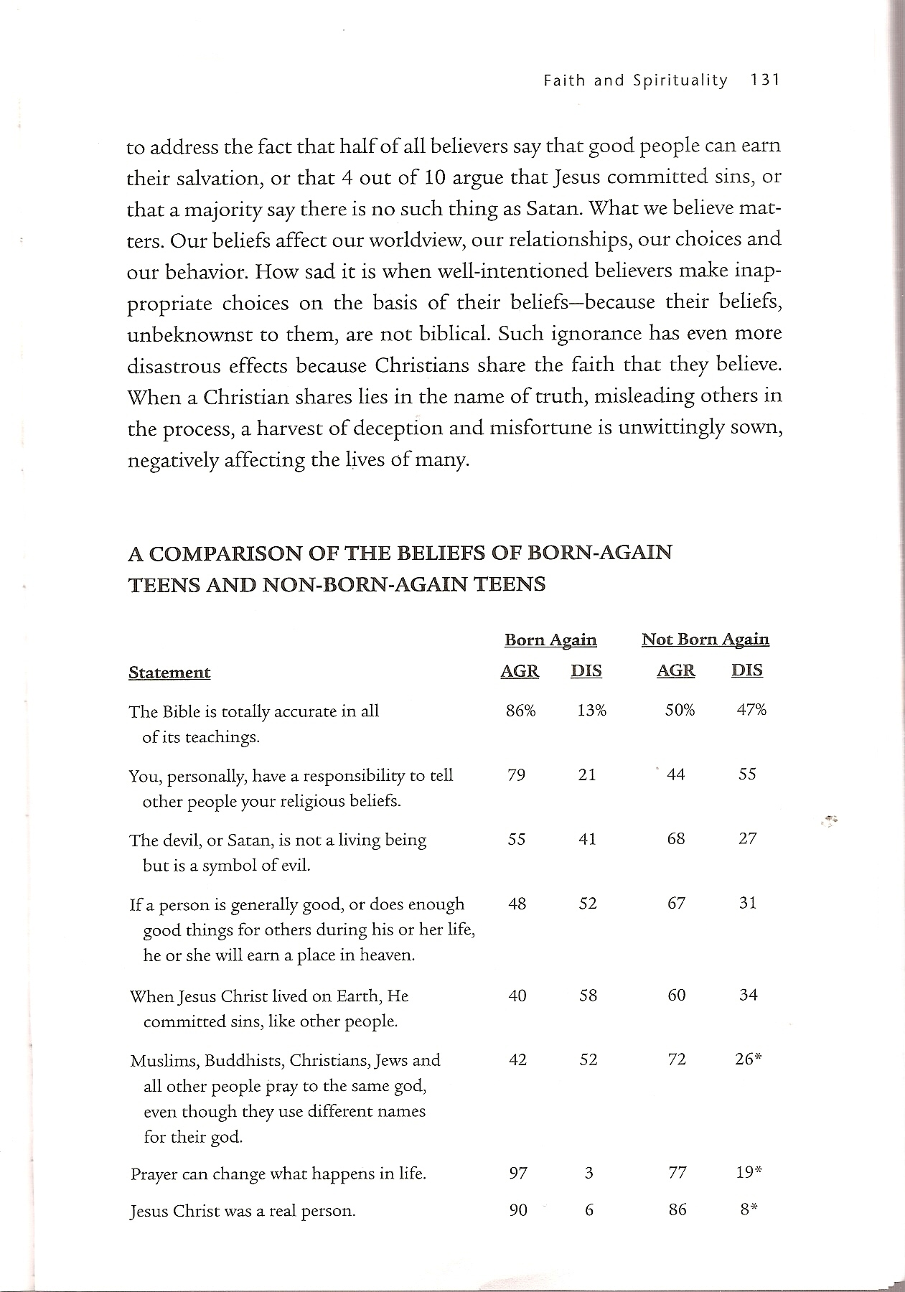
Notes:
A Comparison of the Beliefs of Born-Again Teens and Non-Born-Again Teens.

Slide 23
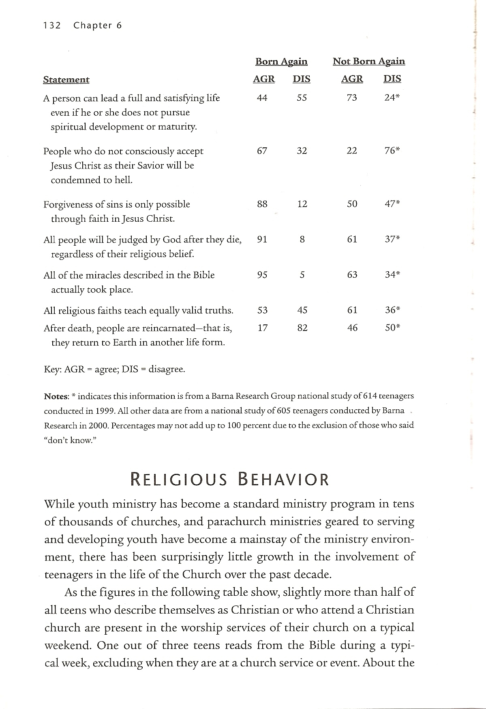

Slide 24


What Makes a Church Appealing?
People are friendly & care about each other
A Community with genuine relationships, supportive & family- oriented
High quality teaching & preaching
Theological beliefs and doctrine of the church
Quality of programs and classes for children
The church being involved in helping poor and disadvantaged people
Notes:
What Makes a Church Appealing?
People are friendly & care about each other
A Community with genuine relationships, supportive & family- oriented
High quality teaching & preaching
Theological beliefs and doctrine of the church
Quality of programs and classes for children
The church being involved in helping poor and disadvantaged people

Slide 25
Barna’s Advice for Youth Leaders
Understand the world of the teenager—the cultural context of the young person. Read their magazines, watch their TV shows, talk to them…
Enter with a Worldview—integrate your faith into their practical life. Teens are impacted by your modeling.
Enter with a philosophy of Youth Ministry.
Pray daily for the development of teens.
Find resources that help you to be effective.
Notes:
Barna’s Advice for Youth Leaders
Understand the world of the teenager—the cultural context of the young person. Read their magazines, watch their TV shows, talk to them. A youth leader must retaining a balance of biblical values and cultural sensitivity—with the dominant culture of concern being that of the young person, not the adult.
Enter with a Worldview—integrate your faith into their practical life. Teens are impacted by your modeling.
Enter with a philosophy of Youth Ministry—Youth workers who affect the most lives do so because they have carefully and painstakingly thought through their philosophy of human development, the nature of the youth subculture, the role of Christianity in a young person’s life, and the place of the youth worker and his ministry efforts in the young person’s growth process. They have a clear vision of why they are engaged in youth work, how their efforts fit into a continuum of moral and spiritual development in a young person’s life.
Pray daily for the development of teens—Effective youth leaders pray for the development of each of the teenagers with whom they are interacting. Their prayers have three elements: a) they identify each teen by name; b) they address the particular needs of each teen in the group; c) they intercede on behalf of each young person every day.
Find resources that help you to be effective—these leaders are unwilling to let a mere absence of material goods or relational connections stand in the way of transforming young lives. They make calls to friends, raise funds to ensure resources are available.

Slide 26

George Barna’s Advice
for Parents
Guide Teens in Their Search for Meaning
Define Appropriate Values
Family Connection
•Faith Connection
Notes:
George Barna’s Advice for Parents
Searching for Meaning – most teens go through a search for significance, seeking to discern meaning, purpose and truth in life. Parents should not force a worldview or philosophy of life upon young individuals, but they can provide key insights and connections that will help them see life from a different vantage point. Ask questions, clarify with them and constantly communicate what he or she is thinking and feeling, and offer wisdom along with a battery of clarifying, non-threatening questions for the youth to consider. Provide the teen with encouragement and reinforcement when he or she appears to make progress.
Define Appropriate Values – Parents who live in accordance with a consistent and Christian value set have a much greater chance of seeing those values absorbed by their children and teens than do parents who leave it to chance and hope for the best. Discussing these choices is only one element in the process; demonstrating what they look like, in practice, is the most powerful influence.
Family Connection – Most teens want to feel as if they are part of a family that knows them, loves them and will look out for them. Parents must provide focused leadership to family members; have a vision for what kind of family they want to have and the strategies it will take to facilitate such a family experience. Provide young people with outlets for their physical development, emotional growth, spiritual maturation and intellectual curiosity. An earlier study by the Barna Group indicated clearly that a huge gift to children is for their parents to remain married. A husband wife staying together through the myriad joys and conflicts of marriage sends a compelling message to young people about commitment, loyalty, love and sacrifice. Perhaps more than anything else, staying married provides kids with a permanent, treasured gift.
Faith Connection – The keys to successfully passing on faith from one generation to another relate to making faith central to one’s existence, avoiding lifestyle hypocrisy and integrating faith behaviors and values into everything the family does as a unit and as individuals.

Slide 27



Conclusion
The teen is open to religion. He/she is vulnerable. He/she is an inquirer, he does not accept everything that he is told, he wants proof, he wants to see, but he is receptive. It is a great phase of life. A great opportunity to make a vulnerable decision for Jesus.
Satan has taken advantage of this phase to destroy the life of God’s children.
Notes:
Conclusion
The teen is open to religion. He/she is vulnerable. He/she is an inquirer, he does not accept everything that he is told, he wants proof, he wants to see, but he is receptive. It is a great phase of life. A great opportunity to make a vulnerable decision for Jesus.
Satan has taken advantage of this phase to destroy the life of God’s children.
The Church has slept while the hungry wolf takes its children.
Another reason is something that we have already. For me, here is the center of the reaction of the teen toward religion.
The individual, who teaches religion, needs to practice what he teaches. This was one of the great questions in the period that Jesus lived. The religious leaders taught, however they did not practice what they were preaching.
Another reason is something that we have already mentioned: The inconsistency between what is practiced and what is preached.
“Then Jesus said to the crowds and to his disciples: “The teachers of the law and the Pharisees sit in Moses’ seat. So you must obey them and do everything they tell you. But do not do what they do, for they do not practice what they preach. They tie up heavy loads and put them on men’s shoulders, but they themselves are not willing to lift a finger to move them”. (Matthew 23:1-4, NIV)
The teen’s sense of justice is very sharp. They can be temporally deceived, but they will soon realize that , that individual who is teaching them does not practice what he preaches.

Slide 28

What Can Be Done?
A specific ministry to work with teens. We cannot waste this phase. If we maintain them in Christ at this age, the possibilities that they will remain in Him for their entire life is very great.
Tomorrow can be too late!
Notes:
What Can Be Done?
A specific ministry to work with teens. We cannot waste this phase. If we maintain them in Christ at this age, the possibilities that they will remain in Him for their entire life is very great.
Tomorrow can be too late!

Slide 29
References
George Barna, Real Teens (Ventura, CA: Regal Books, 2001)
Philip Schwadel & Christian Smith, “Portraits of Protestant Teens: A Report on Teenagers in Major U.S. Denominations (Chapel Hill, NC: National Study of Youth and Religion (NSYR), 2005.)
Roger Dudley, Why Teenagers Reject Religion and What to Do About It (Hagerstown, MD: Review and Herald Publishing Association, 1978).
Roger Dudley, The Complex Religion of Teens (Hagerstown, MD: Review and Herald Publishing Association, 2007).
Samuel Pfromm Netto, Psychology of Adolescence (Sao Paulo: Pioneira, Brasilia, INL, 1976.
Christian Smith & Melinda Lunquist Denton, Soul Searching: the Religious and Spiritual Lives of American Teenagers (Oxford University Press, 2005)
Notes:
References
George Barna, Real Teens (Ventura, CA: Regal Books, 2001)
Philip Schwadel & Christian Smith, “Portraits of Protestant Teens: A Report on Teenagers in Major U.S. Denominations (Chapel Hill, NC: National Study of Youth and Religion (NSYR), 2005.)
Roger Dudley, Why Teenagers Reject Religion and What to Do About It (Hagerstown, MD: Review and Herald Publishing Association, 1978).
Roger Dudley, The Complex Religion of Teens (Hagerstown, MD: Review and Herald Publishing Association, 2007).
Samuel Pfromm Netto, Psychology of Adolescence (Sao Paulo: Pioneira, Brasilia, INL, 1976.

