Slide 1
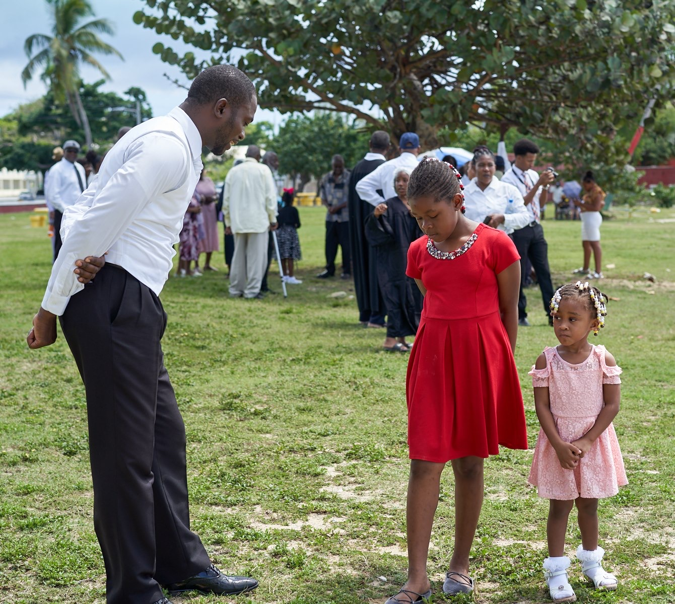
Growing Christian Values in Children
Children’s Ministries Certification
Level 3, Course 1

Slide 2
Psalm 1:1-3
“Blessed is the man who does not walk in the counsels of the wicked . . . But his delight is in the law of the Lord . . . He is like a tree planted by streams of water . . . Whatever he does prospers.”

Slide 3
The Values Tree
Good genetic stock
Good soil – “goodness of fit”
Sunshine – of love and warmth
Watering – with gentle teaching from God’s Word and life experiences
Fertilizer – special teaching experiences
Pruning – discipline
Protection – from winds/storms
Strong Values Needed
“Children need more than good food, a nice physical environment and psychological understanding; they need to learn ethical principles—a firm notion of what they ought to do, and what they ought not to do, and why?”
Robert Coles, Family Weekly

Slide 4
Ellen G. White’s Counsels
“Parents, teach your children . . . how to conduct themselves in the home with true politeness. Educate them to show kindness and tenderness to one another. . .The principles of heaven are to be brought into the government of the home. Every child is to be taught to be polite, compassionate, loving, pitiful, courteous, tenderhearted.” Child Guidance, 143
Why Are Values Important?
Light the dark moments of decision
Point the way to the path of integrity and honesty
Keep the soul in tune with God
Provide a sense of purpose
Direct the means and ends of actions
Are standards of conduct

Slide 5
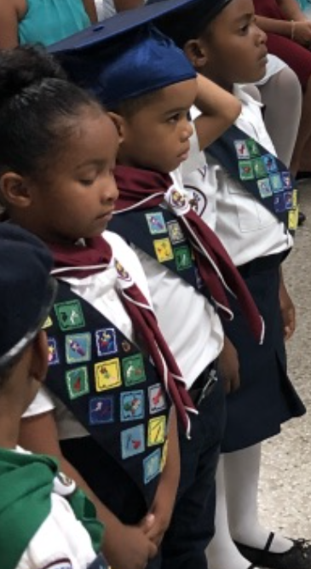
Values Begin with God
Without God, values die
God is no longer the source of values for most people
God’s values are sometimes drastically different from the secular values
What are God’s values?
Galatians 5:22,23
2 Peter 1:5-7
1 Corinthians 13
Matthew 5:3-11

Slide 6
What Values Are Important to You?
Faith
Respect
Kindness and compassion
Honesty and integrity
Patience
Humility and peace
Responsibility
Self-control
Loyalty and commitment
Contentment and thankfulness
All values are rooted in LOVE!

Slide 7
Effective Methods of Values Transformation
1. MAINTAIN POSITIVE RELATIONSHIPS
"As the very best friends of these inexperienced ones, parents should help them in the work of overcoming…They should consider that their own dear children who are seeking to do right are younger members of the Lord's family…With loving interest they should teach them day by day what it means to be children of God and to yield the will in obedience to Him. Teach them that obedience to God involves obedience to their parents. This must be a daily, hourly work. Parents, watch, watch and pray, and make your children your companions.” -- Child Guidance, p. 496

Slide 8
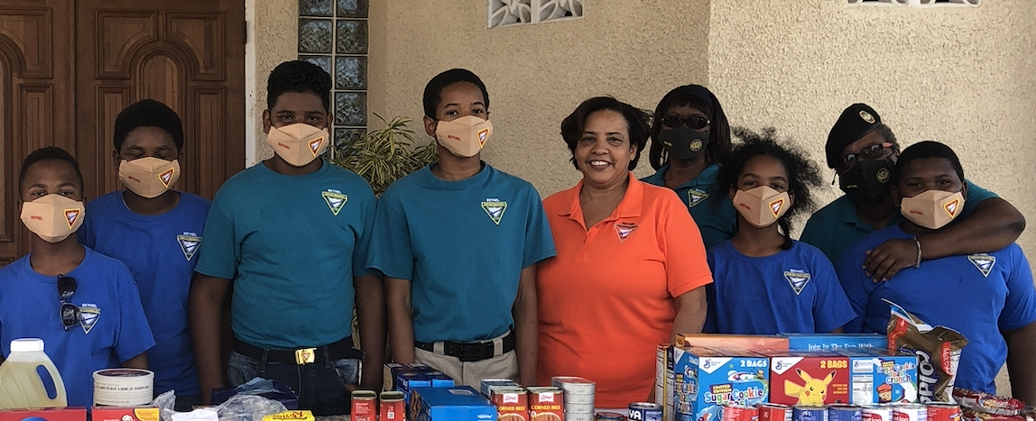
Effective Methods of Values Transformation
2. MODELING
What Do They Model?
Parents/teachers’ actions, words, and demeanor.
How they treat others and treat them.
Their attitudes and behaviors.
How to handle disappointments.
What Christians do when they make mistakes—forgiveness in Christ.
How God is at work in their lives.

Slide 9
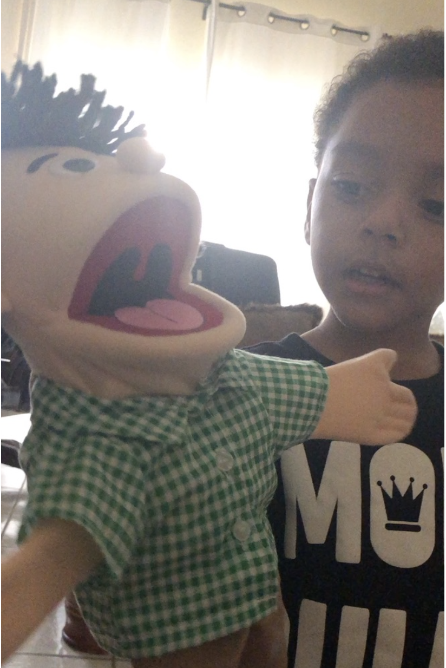
Dwight Moody
“Where one reads the Bible, a hundred read you and me.”
Testimonies, vol. 6, p. 119
"Parents are giving to their children an example either of obedience or of transgression. By their example and teaching, the eternal destiny of their households will in most cases be decided. In the future life of the children will be what their parents have made them."
•
•

Slide 10
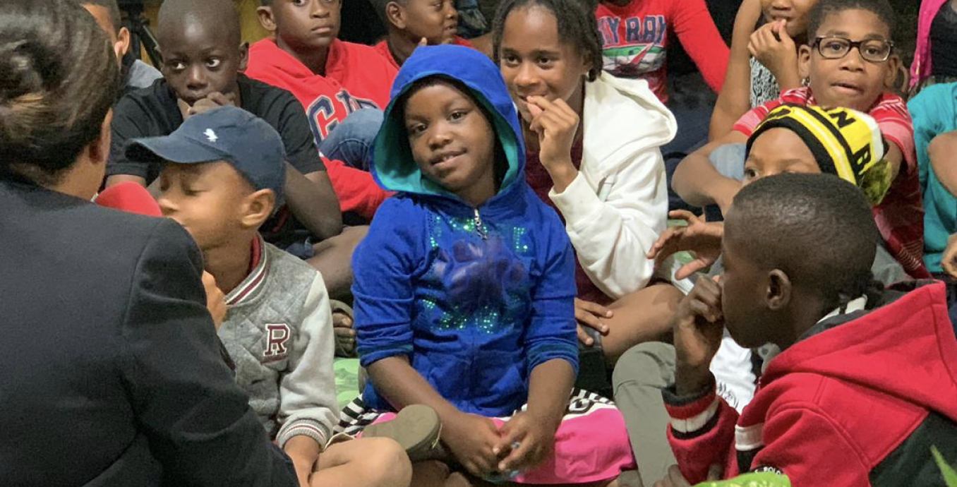
Effective Methods of Values Transmission
3. TEACHABLE MOMENTS
“You shall love the Lord your God with all your heart, with all your soul, and with all your strength. And these words which I command you today shall be in your heart. You shall TEACH them diligently to your children, and shall talk of them when you sit in your house, when you walk by the way, when you lie down, and when you rise up.” Deuteronomy 6:5-7

Slide 11
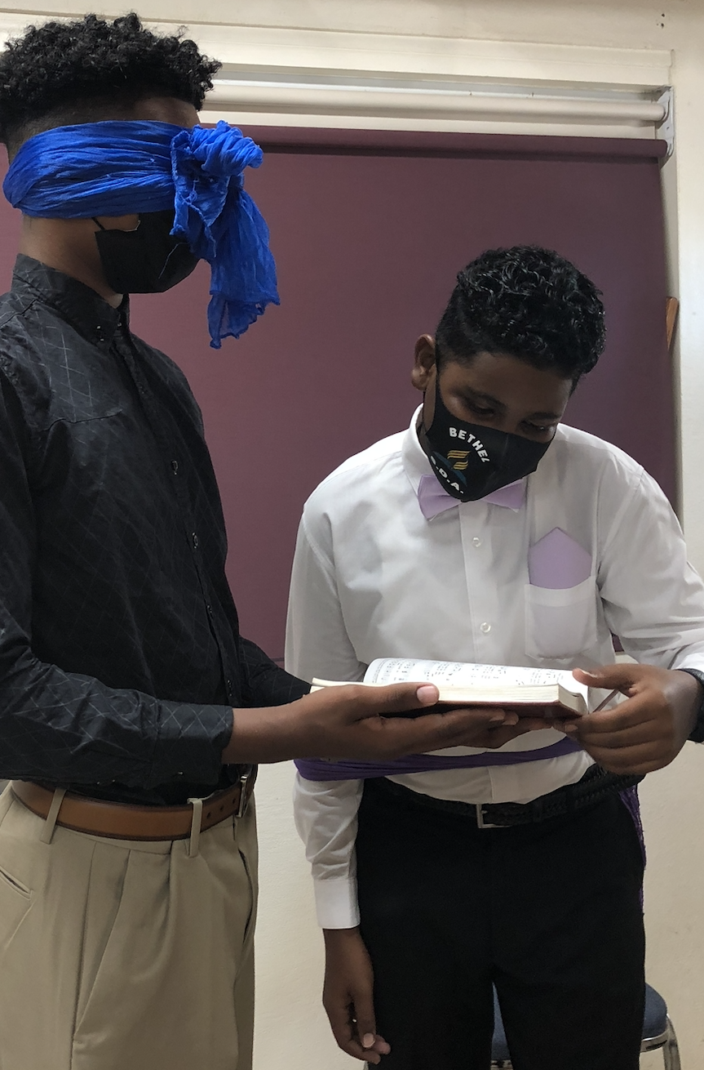
John Gardner, Self-Renewal, 21
“All too often we are telling our young people to cut flowers when we should be teaching them to innovate. We think of the mind as a storehouse to be filled when we should be thinking of it as an instrument to be used.”
Teaching Strategies:
Stories
Questions
Real-life situations
Act-it-out scenes
Posters and pictures
Values journal
Post Bible verses in strategic places
Pray with children every day

Slide 12
Effective Methods of Values Transmission
4. POSITIVE DISCIPLINE
Discipline Guidelines
Correct misbehaviors with love
Explain the reason for punishment if there is a need for it, but love should always be the basis of correction
Avoid being authoritarian – authoritarian parents & teachers who control children through punishment and reward retard moral growth.
Adults who treat children with respect, fairness and consideration, promote moral growth.

Slide 13
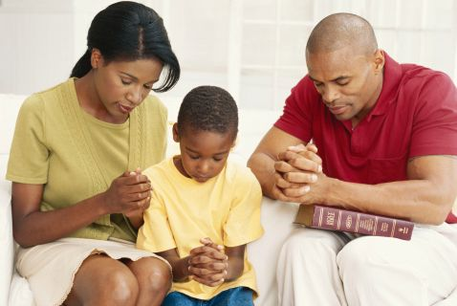
Effective Methods of Values Transmission
5. ESTABLISH FAMILY ALTAR
The Value-Genesis Project asked participants, “How often does your family have worship?” VG2 VG1
Never 23% 26%
Less than once a month 13% 11%
About once a month 7% 6%
About 2-3 times a month 9% 8%
About once a week 16% 15%
Several times a week 11% 11%
Once a day 15% 15%
More than once a day 6% 8%

Slide 14
Values of Family Worship
Opportunity for covenant renewal
Rehearsal of religious heritage
Testimony sharing
Values exploration and instruction
Relationship building

Slide 15
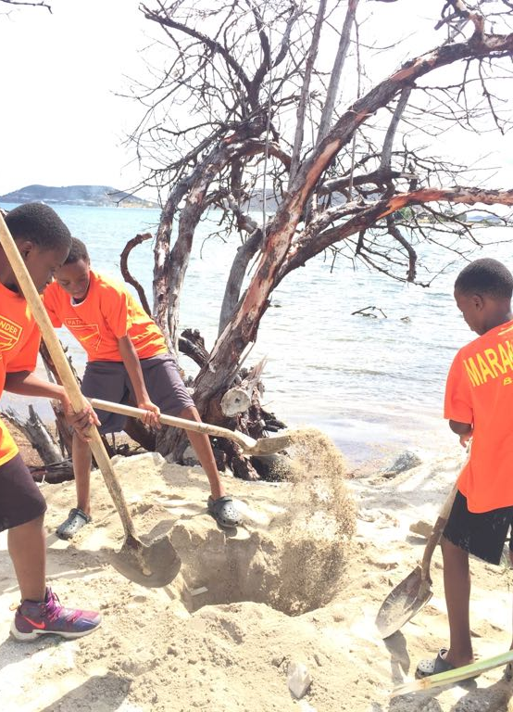
Effective Methods of Values Transmission
6. INVOLVEMENT IN SERVICE
Service Projects
Start an "adopt a grandmother/grand-father program:
Make cheery cards for placement on food trays in the hospital & nursing home.
Volunteer at a local soup kitchen.
Clean up a park.
Rake leaves, cut grass, etc. for elderly.
Bake cookies to give to poor students.

Slide 16
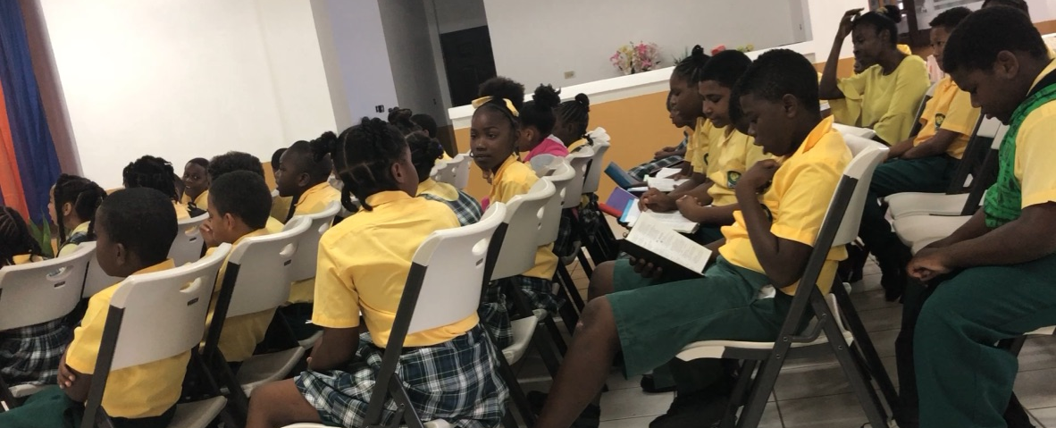
About once a week | 16% | 15%
Several times a week | 11% | 11%
Once a day | 15% | 15%
More than once a day | 6% | 8%
The Responsibility of Parents and Teachers
Live the values
Teach the values
Make right and wrong very clear
Give lots of practice in making decisions
Show your child how to deal with peer pressure

