Slide 1
News Writing and Reporting
By Corliss Smithen
6 May, 2018

Slide 2
INTRODUCTION

Slide 3
What is News?
New
Unusual
Interesting
Significant
About people

Slide 4
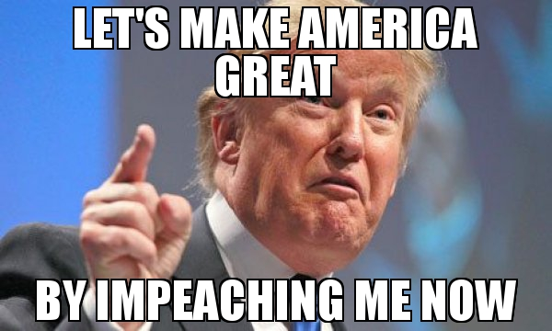
Timeliness
NOT NEWS
Businessman, Donald J. Trump, has been elected the 45th president of the United States.
NEWS
In the face of certain impeachment and removal from office, U.S. President Donald J. Trump demitted office last night after just a year and half at the helm.

Slide 5
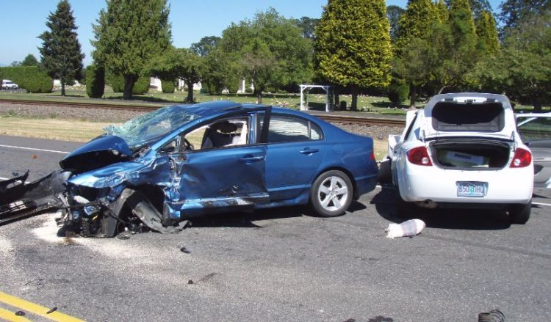
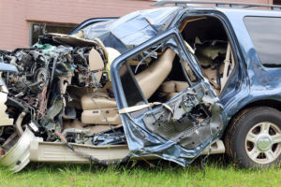
Proximity or closeness
NOT NEWS
Three people died yesterday in a two-car accident in Luxembourg City.
NEWS
A woman and her three children died yesterday when the car they were travelling in crashed into a pole along Veteran’s Drive.

Slide 6
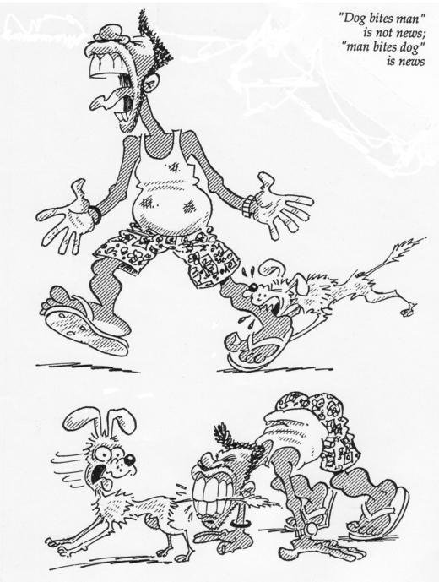
Rarity NOT NEWS
NEWS

Slide 7
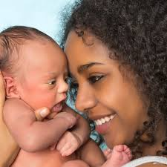
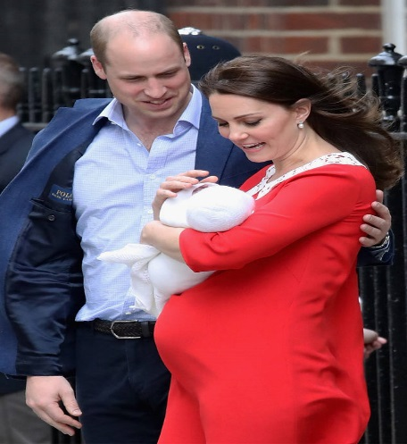
Eminence and Prominence
NOT NEWS
My next-door neighbor, Donna Greene, gave birth to a healthy baby boy last night.
NEWS
The Duke and Duchess of Cambridge has welcomed their new prince into the world. He’s fifth in line to the British throne.

Slide 8
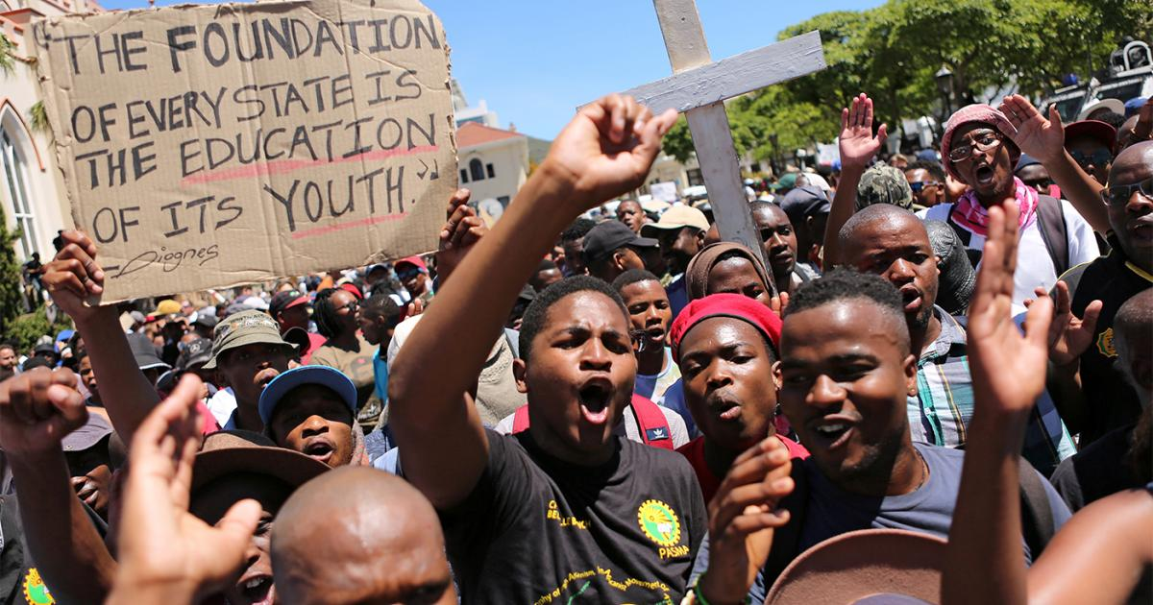
Impact
NOT NEWS
Kenya is set to increase fees for state-sponsored students in public universities by 30% this year, sparking student protests across the country.
NEWS
Parents of students attending the St. Thomas/St. John Seventh-day Adventist School will have to dig deeper in their pockets after school principal, Dr. Whitman Browne, announced plans for a 100% tuition increase, come next semester.

Slide 9
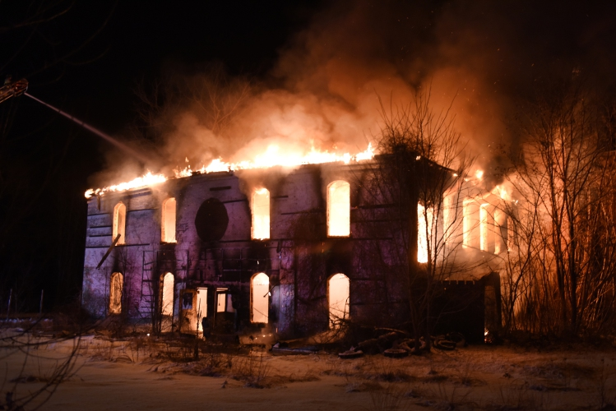
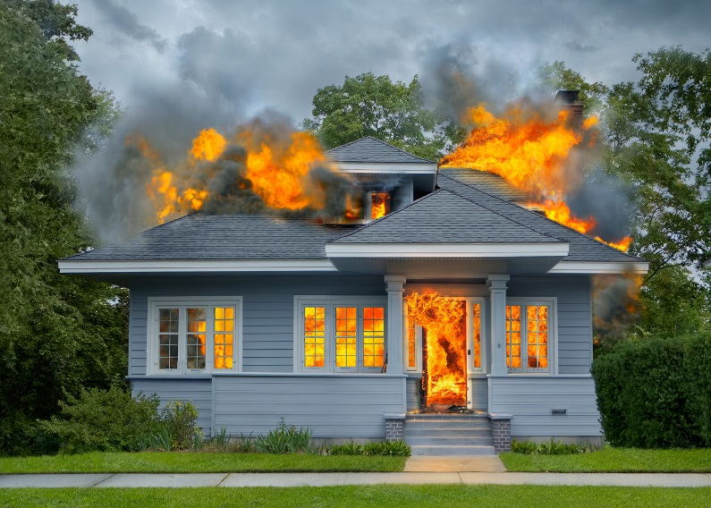
Human Interest
NOT NEWS
A vacant building that was once used as a storage center was destroyed last night in a fire.
NEWS
A family of four has been left homeless after a fire ripped through their home last night, destroying everything in its path.

Slide 10
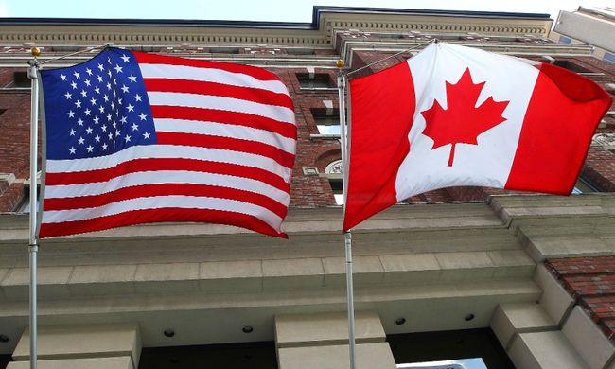
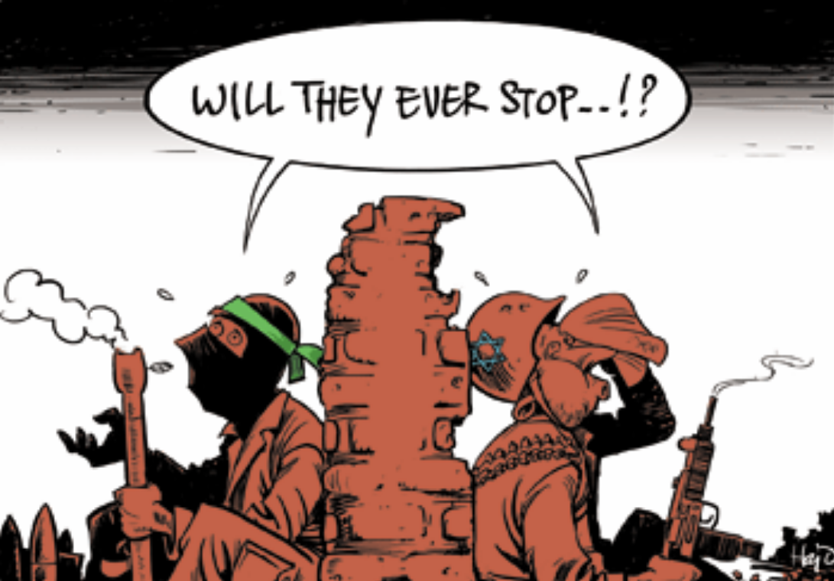
Conflict and Tension
NOT NEWS
The United States and its northern neighbor, Canada, continue to remain ambivalent allies.
NEWS
The Palestinian Authority has declared Saturday a day of national mourning after 17 Palestinians were killed by Israeli forces as thousands marched near Gaza's border with Israel in a major demonstration marking the 42nd anniversary of Land Day.

Slide 11
Types of News Stories
Straight news/hard news
Soft news
Feature news
Human interest stories
Editorial

Slide 12
Types of News Stories
Straight news/hard news
●factual and objective account of a timely event that takes place within 24 hours
● is of concern
● must be covered as it happens
● can be classified as a spot news or breaking news, such as a bank robbery, a murder, a school shooting
E.g. V.I. police officers freed on $100,000 secured bond

Slide 13
Types of News Stories
Soft news
less timely than hard news
consequence and importance less significant
is not always based on current events.
E.g. How To Find Beauty Products That Aren’t Totally Killing The Planet by HuffPost.

Slide 14
Types of News Stories
Feature stories
used to inform or entertain
based on visuals and quotations
usually longer and more detailed than a news story.
E.g. Students’ apathy – a growing concern for educators

Slide 15
Types of News Stories
type of feature stories
discuss a person or people in an emotional way
present people and their problems, concerns or achievements
to bring about interest, sympathy or motivation in the reader or viewer.
E.g. Adventists on St. Thomas “cast down, but not destroyed”
Human interest stories

Slide 16
Types of News Stories
Editorial
used to communicate personal points of view about current events and topics
used to develop an argument about an issue
used to sway readers’ opinions
is not objective
represents the official view of an editorial board
E.g. Will the court stand up to Donald Trump?

Slide 17
Writing a News Story
The Headline
identify the key terms in your article
be accurate and direct
keep it short
use active voice
do not repeat the lead (lede)
know when to capitalize
write in present tense
E.g. Mapp announces ambitious road repair project (V.I. Daily News)

Slide 18
Writing a News Story
The Byline
Gives the name of the writer of the article
Commonly placed after the headline and before the text of the article

Slide 19
Writing a News Story
The Dateline
geographic identifier at beginning of news article or press release
includes the name of a city or town followed by an abbreviation of a state name; all letters are usually capitalized
placed after bylines and on the same line of the first sentence of news articles or press releases.
separated from the first sentence by a dash
E.g. ST. THOMAS, U.S.V.I. –

Slide 20
Writing a News Story
The Lead (Lede)
5 W’s and one H
Who
What
When
Why
Where
How
E.g. Gov. Kenneth Mapp unveiled an ambitious $1.2 billion plan Tuesday to overhaul the territory’s broken public road system — a project, he said, that aims to make potholes a “thing of the past.”

Slide 21
Writing a News Story Types of Leads
Story summary lead
a summary of the whole story in as few words as possible in a single sentence
most traditional lead
to the point and factual
focusses on the who and what of the story, then follows with the when and where.
the how and why may be explained further into the story.

Slide 22
Writing a News Story
Story summary lead
(Points to remember)
use few words, max. of 30, to write a summary of the most newsworthy fact
pick out the most important details and include the 5 W’s and H, beginning with the subject (who or what)
cite sources, if applicable
try to conceal identification, if possible, in the lead
give the reader the subject’s name and title in the paragraph that follows
E.g. GHANA – Two social workers are under investigation for allegedly selling a day-old baby for $3,600 (£2,600) after faking the baby's death.
E.g. GENEVA, SWITZERLAND – The World Health Organization (WHO) is warning that the fight against malaria has stalled for the first time in a decade.

Slide 23
Writing a News Story
Creative lead
use creativity to begin the story
sometimes writers begin with the conclusion, then build on the story
useful in writing human interest or feature articles; rarely used in writing straight or hard news
most important facts usually appear about the third paragraph, called the nut graph
nut graph contains essence of the story.

Slide 24
Writing a News Story Types of Creative Leads
Scene-setting lead
Storytelling lead
can be used for graduation and similar events
begin with a description of a scene of the event
tell the rest of the story in the succeeding paragraphs.
use a narrative style
begin by introducing main characters, conflicts, setting of the story
pique readers’ interest and curiosity with the use of literary devices and expressions
delay identification of persons in the story until a later paragraph to avoid disrupting the flow of the lead

Slide 25
Writing a News Story Types of Creative Leads
Startling statement lead
Opposite lead
begin the story with an amazing fact or startling statement that arouses the readers’ interest
reporting on an important speech delivered by the NCC president or on the findings of a survey or a research, begin with the most startling piece of information the president imparted or the most amazing fact the research uncovered
arrest the readers’ attention and make them want to read the rest of the story
begin with one point of view or observation
follow with an opposite view

Slide 26
Writing a News Story
The Inverted Pyramid
Most Newsworthy Information
(5 W’s and one H)
____________________
Important Details
____________________
Other General and Background
information

Slide 27
Writing a News Story
The Basics of AP Style
Numbers
Street, avenue and boulevard
State and organization names
Months
Titles

Slide 28
Writing a News Story
Quick Course in Grammar and Punctuation
Subject-verb agreement
Pronoun agreement
Subject and object pronouns
Avoid dangling modifiers
Avoid misplaced modifiers
Make sure words are spelt correctly
Use words correctly

Slide 29
Writing a News Story Writing Exercises
Write a lead from the facts below, paying attention to the who, what, why, when, where, and how details:
There was a shooting at Ulke Gade. A young man was killed. The incident occurred on Monday March 7, 2018 at 7 p.m.
Police are investigating Monday night’s shooting at Ulke Gade, which claimed the life of a young man.
Or
A young man was killed Monday night during a shooting at Ulke Gade.

Slide 30
Writing a News Story Writing Exercises
Write a news story, using the inverted pyramid style, from the facts below. The official source of information is police spokeswoman Joan Freeman, who should be credited throughout the story.
Facts:
Who: John Meade, 50, and his wife, Annie Meade, 45, of Smith Bay
What: found shot to death
Where: inside their home – John Meade’s body lay on the bathroom floor. Annie Meade was found dead in her bed.
When: Sunday at 8 a.m.
How: Annie Meade had a single gunshot wound to the head. John Meade was shot multiple times about the body.
Police rushed to the scene after a neighbor called 911 to report shots fired. Police broke down the front door to gain entry into the house, where they found the couple fatally shot. Police have no leads and are asking the public for help in their investigations. Anyone with information is asked to call the Crime Stoppers’ anonymous tipline at 1-800- 222-TIPS.
Couple found shot to death inside their home
By ……………..
ST. THOMAS, V.I. – A man and his wife were found shot to death in their Smith Bay home Sunday morning, according to VIPD spokeswoman, Joan Freeman.
Police responding to a 911 report of shots fired found the bullet-riddled bodies of John Meade, 50, and his wife, Annie Meade, 45, inside the house. Officers broke down the door to gain entry into the house where they found John Meade, who was shot multiple times about the body, on the bathroom floor. Annie Meade still lay in her bed with a gunshot wound to the head and one in the chest, Freeman said.
Police have no leads and are asking the public for help in their investigations. Anyone with information is asked to call the Crime Stoppers’ anonymous tipline at 1-800- 222-TIPS.

Slide 31
Works Cited

Slide 32
SPJ Code of Ethics
Seek truth and report it
Minimize harm
Act independently
Be accountable
Details available
Details available
Details available
Details available

Slide 33
End of Presentation

